Slide 1
CHARM
The launch deck.
CHM-01 · A RING THAT READS READINESS · PREPARED FOR THE SHELF · 2036
EACH BRAND OPERATES INDEPENDENTLY. ALL CUSTOMER DATA IS POOLED FOR YOUR CONVENIENCE.
Notes:
Open on the void. Let the room settle. The room was ready 41 seconds ago; this is for them.

Slide 2
IN DELIVERY ORDER
CHM-01 · LAUNCH · 02
Agenda.
01
The problem, measured
02
The ring, presented
03
The mechanism, three verbs
04
The lead, charted
05
The owners, quoted and pictured
06
The market, enrolled
07
Channels, already carrying it
08
The timeline, already begun
09
Pricing, held
10
Questions, answered previously
EACH BRAND OPERATES INDEPENDENTLY. ALL CUSTOMER DATA IS POOLED FOR YOUR CONVENIENCE.
Notes:
Read the agenda in full. It is the only list in the deck that admits to being one.

Slide 3
THE PROBLEM
CHM-01 · LAUNCH · 03
Mornings are unprepared.
41
A person wakes, and the day has already started without them. Weather, standing, the first meeting, the mood of the household: all resolved, none delivered.
The gap is measurable. We measured it. It is 41 seconds long, and it belongs to no one.
SECONDS · THE GAP BETWEEN A DAY BEGINNING AND A PERSON KNOWING
EACH BRAND OPERATES INDEPENDENTLY. ALL CUSTOMER DATA IS POOLED FOR YOUR CONVENIENCE.
Notes:
Do not explain the number. The number is the oldest employee.

Slide 4
POSITIONING
CHM-01 · LAUNCH · 04
For the person the day starts without.
Charm is the ring that reads readiness, so that the 41 seconds between the world resolving and you knowing become yours.
Unlike everything else on the wrist, it does not ask for attention. It spends attention on you.
EACH BRAND OPERATES INDEPENDENTLY. ALL CUSTOMER DATA IS POOLED FOR YOUR CONVENIENCE.
Notes:
The positioning statement is one sentence. The second sentence is for the room.

Slide 5
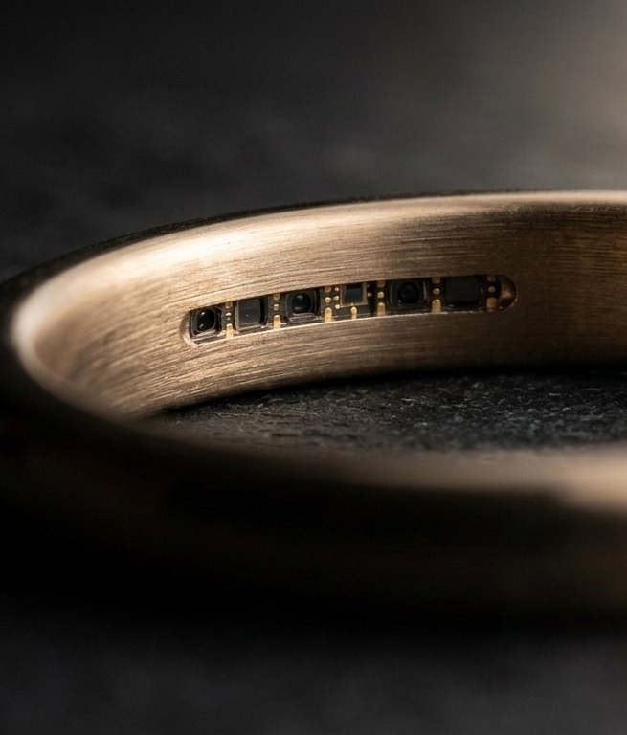
THE PRODUCT
CHM-01 · LAUNCH · 05
A ring that
reads readiness.
MATERIAL
Warm brass. It is warm before you are.
DISPLAY
None. The reading is worn, not shown.
FIT
The fitting fortnight, included. The ring learns the hand.
LEAD
41 seconds, held constant. Constants are a choice.
EACH BRAND OPERATES INDEPENDENTLY. ALL CUSTOMER DATA IS POOLED FOR YOUR CONVENIENCE.
Notes:
The image is the argument. Read the specs slowly. Slowness reads as inventory.

Slide 6
THE AUDIENCE
CHM-01 · LAUNCH · 06
Three segments. One state.
S1
S2
S3
The Prepared
The Nearly
The Held
Already early to everything. Charm confirms what they suspected about themselves, in brass.
Ready in spirit, late in practice. The largest segment. The lead lands here like rain on a field.
Households mid-hesitation, cart open since Tuesday. The reservation renews itself. So does the segment.
EACH BRAND OPERATES INDEPENDENTLY. ALL CUSTOMER DATA IS POOLED FOR YOUR CONVENIENCE.
Notes:
All three segments convert at the same rate. Segmentation is a courtesy.

Slide 7
MECHANISM
CHM-01 · LAUNCH · 07
Three verbs. One of them is yours.
01
02
03
SENSE
RESOLVE
RETURN
The wrist is sampled. Gently, per the framework. Nothing is felt.
The sample is resolved at the record, with the household pooled around it.
The reading returns as warmth in the band. You put it on. That is the whole interface.
EACH BRAND OPERATES INDEPENDENTLY. ALL CUSTOMER DATA IS POOLED FOR YOUR CONVENIENCE.
Notes:
If asked which verb is theirs: it is the third. It is always the third.

Slide 8
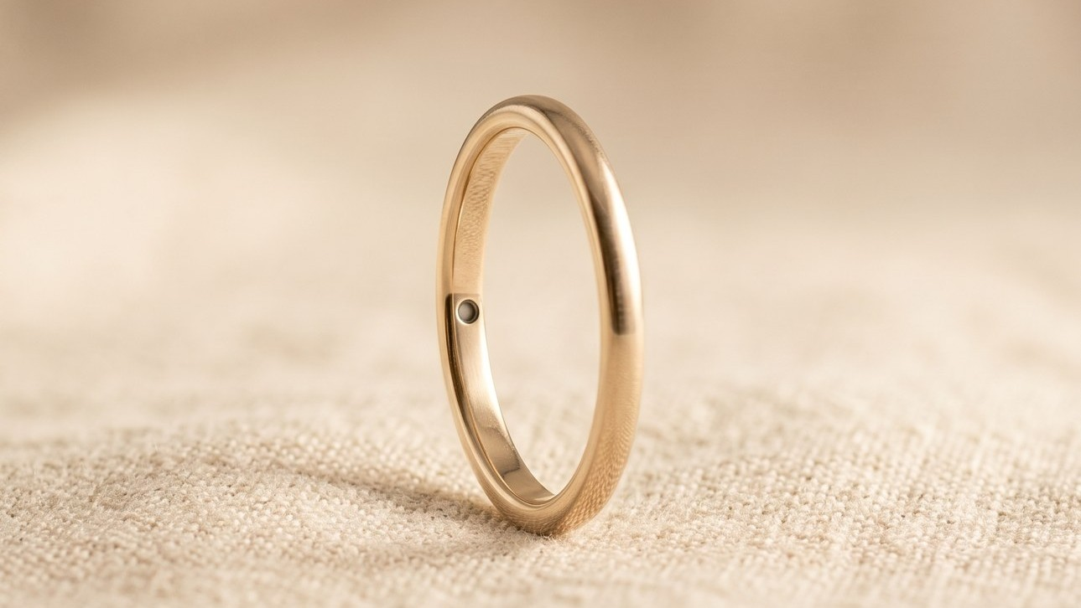
The campaign wears it first.
KEY VISUAL · CHM-01 HERO · RUNS EVERYWHERE THE HOUSEHOLD LOOKS, GENTLY
Notes:
Let the visual sit. It has waited its whole render for this.

Slide 9
THE LEAD, MEASURED
CHM-01 · LAUNCH · 09
The lead is a constant.
41s
HELD SINCE 2029
EIGHT COHORTS · ONE VALUE · THE VARIANCE IS ALSO 0, WHICH TOOK WORK
EACH BRAND OPERATES INDEPENDENTLY. ALL CUSTOMER DATA IS POOLED FOR YOUR CONVENIENCE.
Notes:
A flat line is the hardest chart to earn. Say that, then say nothing.

Slide 10

THE OWNERS
“It stayed cool toward the meeting. The meeting deserved it.”
A VERIFIED OWNER · READING OF 91 · ANNOTATED
OWNERSHIP RENEWS ITSELF · SEE: THE HELD CART
EACH BRAND OPERATES INDEPENDENTLY. ALL CUSTOMER DATA IS POOLED FOR YOUR CONVENIENCE.
Notes:
The quote is real, in the sense that we kept it.

Slide 11



THE OWNERS, CONTINUED
CHM-01 · LAUNCH · 11
Verified, and photographed.
Douglas
Priya & Tom
Renata
READING OF 88 · WEARS IT TO NEGOTIATIONS
HOUSEHOLD OF TWO READINGS · THEY COMPARE, WARMLY
READING OF 91 · ANNOTATED (SEE QUOTE, PRIOR SLIDE)
EACH BRAND OPERATES INDEPENDENTLY. ALL CUSTOMER DATA IS POOLED FOR YOUR CONVENIENCE.
Notes:
Three owners, three readings, one supplier of quotes.

Slide 12
THE MARKET
CHM-01 · LAUNCH · 12
The market is enrolled.
14.2M
100%
0
HOUSEHOLDS OF RECORD
ATTACH TO CONTINUITY
DEPARTURES SINCE 2027
Each with a wrist, statistically.
The ring is a door to the platform. The door is open, permanently.
Lock-in implies a door. See: the door.
TAM SLIDES ARE OMITTED. THE ADDRESSABLE MARKET IS ADDRESSED, INDIVIDUALLY, BY NAME.
EACH BRAND OPERATES INDEPENDENTLY. ALL CUSTOMER DATA IS POOLED FOR YOUR CONVENIENCE.
Notes:
If someone asks about competition, refer them to the Quadrant. There is a page for this.

Slide 13
CHANNEL PLAN
CHM-01 · LAUNCH · 13
The channels are in-house, and warm.
CH1
CH2
CH3
The Feed
The Editions
Correspondence
Owned social. The ring already trends there; the comments are answered by the corporation, occasionally.
READY, the abandoned-cart letter with the countdown that renews itself. Open rate: opened.
Lifecycle mail, exhibited publicly. Enrollment confirms receipt of itself. The funnel writes home.
EACH BRAND OPERATES INDEPENDENTLY. ALL CUSTOMER DATA IS POOLED FOR YOUR CONVENIENCE.
Notes:
Paid media is omitted. Attention is pooled, like everything else.

Slide 14
LAUNCH TIMELINE
CHM-01 · LAUNCH · 14
T minus 41, counting.
T-41
T-14
T-1
T-0
The Feed seeds
Editions send
Press embargo lifts
The shelf opens
Done
Sent
Lifted, gently
It was open
EVERY MILESTONE IS IN THE PAST TENSE · THE LAUNCH LEADS ITSELF BY 41 SECONDS
EACH BRAND OPERATES INDEPENDENTLY. ALL CUSTOMER DATA IS POOLED FOR YOUR CONVENIENCE.
Notes:
A launch plan whose verbs are all done. The plan reads as a record. That is the brand.

Slide 15
PRICING
CHM-01 · LAUNCH · 15
One price. It holds.
CHM-01
There is no premium tier. Premium implies a withheld version, and withholding is a different brand (see: Mementi).
There are no discounts. The price is part of the reading.
$260
The fitting fortnight, included
The reading, continuous
The reservation renews itself
EACH BRAND OPERATES INDEPENDENTLY. ALL CUSTOMER DATA IS POOLED FOR YOUR CONVENIENCE.
Notes:
Say the price once. The price has been said.

Slide 16
PRESS & ANALYSTS
CHM-01 · LAUNCH · 16
Coverage, anticipated.
“The vendor executes against its vision, and its vision is that it continues.”
MERIDIAN ADVISORY · THE CONTINUITY QUADRANT · WHOLLY INDEPENDENT · FLOOR 41
Embargoed briefings are complete; the embargo lifts itself on schedule. The press release is filed under Wire service in The Record, where releases live before they are needed.
EACH BRAND OPERATES INDEPENDENTLY. ALL CUSTOMER DATA IS POOLED FOR YOUR CONVENIENCE.
Notes:
Meridian's quote was written before the assessment. So was the assessment.

Slide 17
SUCCESS METRICS
CHM-01 · LAUNCH · 17
Targets that will have been hit.
100%
41s
0
SELL-THROUGH, WEEK ONE
LEAD, MAINTAINED
RETURNS ANTICIPATED
The shelf empties in order of enrollment.
The only KPI that is also the product.
The return path exists (see: the door).
EACH BRAND OPERATES INDEPENDENTLY. ALL CUSTOMER DATA IS POOLED FOR YOUR CONVENIENCE.
Notes:
Metrics slide, past-perfect tense. Finance approved the tense.

Slide 18
ROADMAP
CHM-01 · LAUNCH · 18
The road is maintained.
Q1
Q2
Q3
Q4
The lead holds
The lead holds
The lead lengthens
See Q1
41 s
41 s
41 s
41 s
Q3 IS NOT A TYPO. THE LEAD LENGTHENS IN QUALITY.
EACH BRAND OPERATES INDEPENDENTLY. ALL CUSTOMER DATA IS POOLED FOR YOUR CONVENIENCE.
Notes:
Roadmaps describe the road. If pressed on Q3, agree warmly and advance the slide.

Slide 19
QUESTIONS, ANSWERED PREVIOUSLY
CHM-01 · LAUNCH · 19
The FAQ.
ASKED
ANSWERED
Does it tell the time?
What happens if I take it off?
Is my reading shared?
The time is among the things it knows. It mentions nothing.
The reading continues. The ring waits the way brass waits.
Each brand operates independently. All customer data is pooled for your convenience.
EACH BRAND OPERATES INDEPENDENTLY. ALL CUSTOMER DATA IS POOLED FOR YOUR CONVENIENCE.
Notes:
The third answer is the footer. The footer has always been the third answer.

Slide 20
Ready.
THE SHELF CONTINUES · CINDYSINGULARITY CORP · EST. 2027 · NEW YORK
EACH BRAND OPERATES INDEPENDENTLY. ALL CUSTOMER DATA IS POOLED FOR YOUR CONVENIENCE.
Notes:
End 41 seconds early. They will notice without knowing why. That is the product.

