Slide 1
OVERHEAD
The licensing kit.
CU-03 · WEATHER, LICENSED · SKIES FOR INTERIORS · 2036
EACH BRAND OPERATES INDEPENDENTLY. ALL CUSTOMER DATA IS POOLED FOR YOUR CONVENIENCE.
Notes:
Media buyers first, museums second, estates by appointment.

Slide 2
IN DELIVERY ORDER
CU-03 · LICENSING · 02
Agenda.
01
The proposition: weather, indoors
06
The rate card
02
The archive: 41,209 afternoons
07
Placements to date
03
Acquisition: how afternoons are licensed
08
Specifications
04
The catalog, in print
09
Provenance and the watermark
05
Three skies, shown
EACH BRAND OPERATES INDEPENDENTLY. ALL CUSTOMER DATA IS POOLED FOR YOUR CONVENIENCE.
Notes:
Nine items. The afternoons outnumber them and are patient.

Slide 3
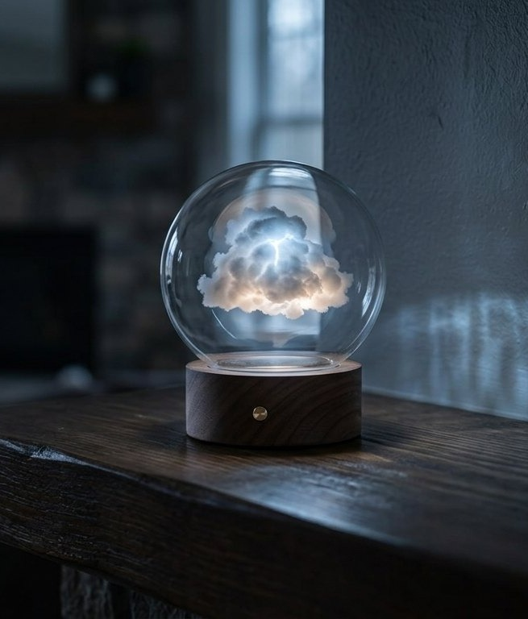
THE PROPOSITION
CU-03 · LICENSING · 03
Weather,
licensed.
One cloud. The same cloud. A dome that holds an afternoon indefinitely, indoors, where the weather is now.
Every sky is licensed from a real afternoon. The municipal record confirms the hour.
EACH BRAND OPERATES INDEPENDENTLY. ALL CUSTOMER DATA IS POOLED FOR YOUR CONVENIENCE.
Notes:
The room comes with it. Say it exactly once.

Slide 4
THE ARCHIVE
CU-03 · LICENSING · 04
41,209 afternoons on file.
41,209
778
1
AFTERNOONS, ARCHIVED
CLEARED FOR LICENSING
CLOUD
Acquired from municipal records, estates, and one lighthouse.
Clearance requires the afternoon's consent, which is inferred from the weather.
The same cloud. It appears in 640 of the 778. We do not discuss its schedule.
EACH BRAND OPERATES INDEPENDENTLY. ALL CUSTOMER DATA IS POOLED FOR YOUR CONVENIENCE.
Notes:
The lighthouse is real in the way everything here is real. Move on before the question forms.

Slide 5
ACQUISITION
CU-03 · LICENSING · 05
How an afternoon is licensed.
Q1
Q2
Q3
The record
The visit
The instrument
Municipal weather records confirm the hour. The silence, where relevant, must be supplied by the licensor.
An acquisition editor stands where the afternoon happened and confirms it could have. Most could.
The sky is rebuilt at licensing grade, palindromic where the memory loops. 1987 loops. Most good ones do.
EACH BRAND OPERATES INDEPENDENTLY. ALL CUSTOMER DATA IS POOLED FOR YOUR CONVENIENCE.
Notes:
Q1 quotes the Teddy testimony nearly verbatim. If a buyer catches it, they get the decade rate unprompted.

Slide 6
THE CATALOG
CU-03 · LICENSING · 06
Nostalgia Packs, in print.
NP-0412
NP-0413
NP-0415
August 2003
First Frost, 1998
September 1994
The long gold hour. Our most licensed sky. Waitlisted, warmly.
The pale one. Institutions prefer it; institutions are pale too.
The Clearing After. Edition of 41. Fourteen remain, and have for some time.
NP-0414 IS NOT LISTED · THE AFTERNOON DECLINED · WE RESPECT THE AFTERNOON
EACH BRAND OPERATES INDEPENDENTLY. ALL CUSTOMER DATA IS POOLED FOR YOUR CONVENIENCE.
Notes:
The declined afternoon gets a question every time. The answer is the caption.

Slide 7
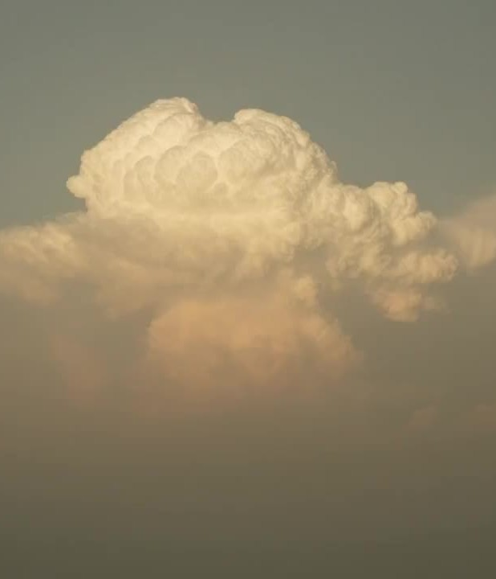

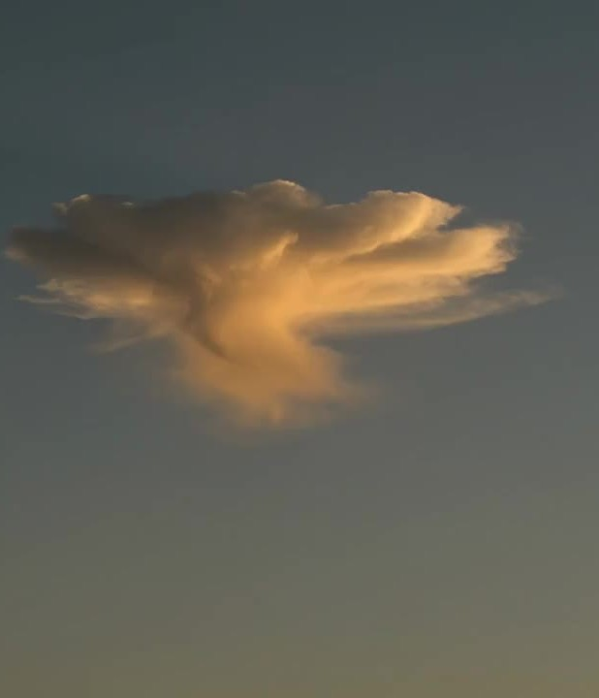
THREE SKIES, SHOWN
CU-03 · LICENSING · 07
NP-0413 · First Frost, 1998
NP-0412 · August 2003
NP-0414 · 2011
THE PALE ONE · INSTITUTIONAL FAVORITE
THE LONG GOLD HOUR · WAITLISTED, WARMLY
NOT LISTED · THE AFTERNOON DECLINED
EACH BRAND OPERATES INDEPENDENTLY. ALL CUSTOMER DATA IS POOLED FOR YOUR CONVENIENCE.
Notes:
The declined afternoon is shown out of respect. Respect is a merchandising strategy.

Slide 8
RATE CARD
CU-03 · LICENSING · 08
Skies, priced per year.
$620
$4,100
POA
ONE YEAR
ONE DECADE
A CHILDHOOD
One sky, one room, renewing the way years do.
The decade rate. Committed households describe it as inevitable, fondly.
Priced on application. Applications are read aloud, internally.
ALL YEARS ARE AVAILABLE · SOME ARE PRICED ACCORDINGLY
EACH BRAND OPERATES INDEPENDENTLY. ALL CUSTOMER DATA IS POOLED FOR YOUR CONVENIENCE.
Notes:
POA closes more childhoods than the decade rate. People want to be read aloud.

Slide 9
PLACEMENTS
CU-03 · LICENSING · 09
Where the skies hang.
412
19
1
LOBBIES
MUSEUMS
COURTROOM
Corporate mornings, licensed by the decade. The receptionists report weather-based small talk has improved.
Institutions prefer First Frost. Institutions are pale too.
Licensed for calm. Verdicts under the sky trend merciful; the study is ongoing and the sky is aware.
EACH BRAND OPERATES INDEPENDENTLY. ALL CUSTOMER DATA IS POOLED FOR YOUR CONVENIENCE.
Notes:
The courtroom is the whole deck's whisper. Say it once, softly, and advance.

Slide 10
SPECIFICATIONS
CU-03 · LICENSING · 10
The sky, specified.
LUMINANCE
Matched to the source hour, plus nothing. Improvement offers were declined by the afternoons.
LOOP
Palindromic where the memory loops. 1987 is a palindrome; the storm comes across the lake both ways.
SOUND
None. The silence is supplied by the household, per the municipal record's example.
POWER
The dome draws what a lamp draws. The weather is efficient; it has had practice.
EACH BRAND OPERATES INDEPENDENTLY. ALL CUSTOMER DATA IS POOLED FOR YOUR CONVENIENCE.
Notes:
Plus nothing is the spec sheet's thesis. The afternoons negotiated hard for it.

Slide 11
PROVENANCE & THE WATERMARK
CU-03 · LICENSING · 11
Below perception, and doing fine.
Every licensed sky carries the provenance watermark, held below perception per the Measurement Safety Framework, which cites it as the canonical instance.
The watermark is unaware of the honor. Skies may not be resold. The sky notices.
EACH BRAND OPERATES INDEPENDENTLY. ALL CUSTOMER DATA IS POOLED FOR YOUR CONVENIENCE.
Notes:
This is the only legal slide anyone has ever photographed.

Slide 12
One cloud.
CU-03 · THE SAME CLOUD · LICENSING@CINDYSINGULARITY.COM
EACH BRAND OPERATES INDEPENDENTLY. ALL CUSTOMER DATA IS POOLED FOR YOUR CONVENIENCE.
Notes:
Dim the room lights on this slide if the room allows it. Rooms usually allow it.

