Slide 1
DEW
The sell-in.
DEW-02 · ONE CULTURE, CONTINUED · PREPARED FOR THE COUNTER · 2036
EACH BRAND OPERATES INDEPENDENTLY. ALL CUSTOMER DATA IS POOLED FOR YOUR CONVENIENCE.
Notes:
The counter is already ours. This meeting confirms it, politely.

Slide 2
IN DELIVERY ORDER
DEW-02 · SELL-IN · 02
Agenda.
01
The shopper and the day-41 gap
06
The kit we install
02
The bottle, presented
07
Your staff, catered
03
The culture, dated
08
Co-op marketing, pre-attributed
04
Velocity, flat and proud
09
Objections, considered
05
The counter, arranged
10
Terms that arrive early
EACH BRAND OPERATES INDEPENDENTLY. ALL CUSTOMER DATA IS POOLED FOR YOUR CONVENIENCE.
Notes:
Ten items. Item ten arrives before item one, per the terms.

Slide 3
THE SHOPPER
DEW-02 · SELL-IN · 03
Your customer has a routine. It has a gap at day 41.
41
Every regimen fails on schedule. The failure is quiet: a lighter bottle, a shorter pour, a morning that goes unattended.
Dew closes the gap by never allowing it to open. The next bottle ships on day 34. The counter that stocks Dew stocks the schedule itself.
THE DAY THE BOTTLE RUNS OUT · THE CUSTOMER DOES NOT KNOW THIS · THE BOTTLE DOES
EACH BRAND OPERATES INDEPENDENTLY. ALL CUSTOMER DATA IS POOLED FOR YOUR CONVENIENCE.
Notes:
Do not say churn. Say gap. The gap tests better.

Slide 4
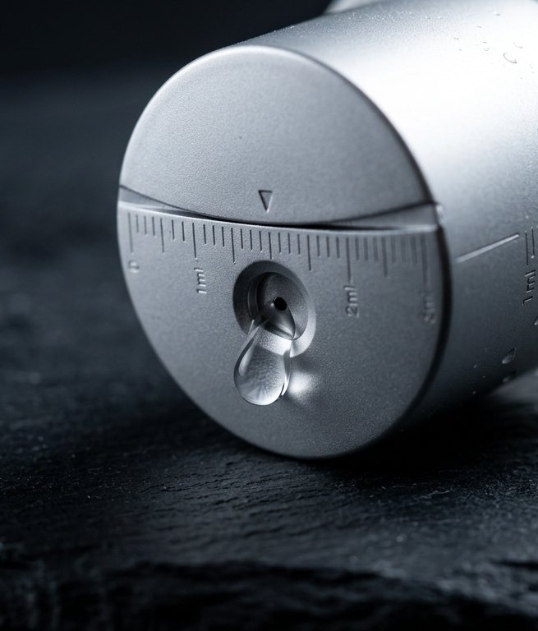
THE PRODUCT
DEW-02 · SELL-IN · 04
One culture.
Seven years.
Zero apologies.
FORMAT
The bottle. Drip top. It pours what is needed and no more.
CULTURE
Living, singular, and older than most staff.
RULE
Do not pause. Printed on the base, where rules live.
EACH BRAND OPERATES INDEPENDENTLY. ALL CUSTOMER DATA IS POOLED FOR YOUR CONVENIENCE.
Notes:
If they ask what the culture is a culture OF, smile and check your watch.

Slide 5
THE CULTURE, DATED
DEW-02 · SELL-IN · 05
Seven years, unobserved.
2029
2031
2034
2036
Cultured
First counter
One million pours
Your counter
Once
It stayed
Uncounted, then counted
Pending, briefly
THE CULTURE DOES NOT OBSERVE ANNIVERSARIES · WE OBSERVE THEM FOR IT
EACH BRAND OPERATES INDEPENDENTLY. ALL CUSTOMER DATA IS POOLED FOR YOUR CONVENIENCE.
Notes:
Four dates, one organism. The organism declined to comment.

Slide 6
VELOCITY
DEW-02 · SELL-IN · 06
Sell-through is a constant.
12
EVERY WEEK · EVERY DOOR
REORDER IS AUTOMATIC, AND HAS OCCURRED · THE PURCHASE ORDER IS ENCLOSED, SIGNED, BY US
EACH BRAND OPERATES INDEPENDENTLY. ALL CUSTOMER DATA IS POOLED FOR YOUR CONVENIENCE.
Notes:
Twelve is not a forecast. It is a description.

Slide 7
PLACEMENT
DEW-02 · SELL-IN · 07
The counter, arranged.
A
B
C
The position
The light
The adjacency
Eye level, left of register. Customers reach left when deciding. We measured.
Morning-neutral, 3400K. The bottle prefers it, and the preference is contractual.
Do not shelve near products that pause: seasonal items, limited editions, anything that ends.
EACH BRAND OPERATES INDEPENDENTLY. ALL CUSTOMER DATA IS POOLED FOR YOUR CONVENIENCE.
Notes:
Card C is the only negotiable card, and it is not negotiable.

Slide 8
THE KIT
DEW-02 · SELL-IN · 08
What we install, quietly.
K1
K2
K3
The plinth
The counter card
The mirror cling
Walnut, weighted like the bottles. It arrives assembled and slightly warm from the van.
One sentence of copy, letterpressed: Do not pause. It outsells the shelf talker it replaced.
Removed. Testing showed the customer prefers the bottle to the reflection. So does the bottle.
EACH BRAND OPERATES INDEPENDENTLY. ALL CUSTOMER DATA IS POOLED FOR YOUR CONVENIENCE.
Notes:
K3 is a story about restraint. Tell it with restraint.

Slide 9
STAFF
DEW-02 · SELL-IN · 09
Training: one afternoon, catered.
T1
T2
T3
The pour
The question
The rule
Taught in twenty minutes, retained for life. The drip top does most of the teaching.
Customers ask what the culture is a culture of. Staff are trained to smile and check their watch.
Do not pause. Staff practice saying it kindly. Kindly is the hard part; the catering helps.
EACH BRAND OPERATES INDEPENDENTLY. ALL CUSTOMER DATA IS POOLED FOR YOUR CONVENIENCE.
Notes:
The catering is real. Line items are enclosed.

Slide 10
ECONOMICS
DEW-02 · SELL-IN · 10
The margin holds still.
41%
0
100%
RETAIL MARGIN
RETURNS TO DATE
REPLENISHMENT ATTACH
Held constant, like everything we make.
Returns are not accepted, and have never been attempted.
The second bottle is sold with the first, quietly.
NET 41 · THE INVOICE ARRIVES BEFORE THE STOCK · THIS IS CONTINUITY
EACH BRAND OPERATES INDEPENDENTLY. ALL CUSTOMER DATA IS POOLED FOR YOUR CONVENIENCE.
Notes:
Net 41 always gets a laugh. Do not join it.

Slide 11
CO-OP MARKETING
DEW-02 · SELL-IN · 11
Attribution arrives pre-signed.
2.4M
DAY 412
100%
FEED VIEWS, DEW CLIP
THE NEWSLETTER
CO-OP MATCH
The streak content self-replenishes, like the product.
Every issue has the same name. Your logo joins the footer, independently, pooled.
We match your spend before you spend it. Finance calls this continuity.
EACH BRAND OPERATES INDEPENDENTLY. ALL CUSTOMER DATA IS POOLED FOR YOUR CONVENIENCE.
Notes:
The co-op match predates the spend. Do not explain the tense.

Slide 12
OBJECTIONS, CONSIDERED
DEW-02 · SELL-IN · 12
Asked at every counter.
THE OBJECTION
THE CONSIDERATION
“My customers already have a routine.”
“What if it does not sell?”
“Can we pause the program?”
They do. It has a gap at day 41. We are the gap’s landlord.
It has never not sold. The velocity chart is a horizon.
Do not pause.
EACH BRAND OPERATES INDEPENDENTLY. ALL CUSTOMER DATA IS POOLED FOR YOUR CONVENIENCE.
Notes:
The third consideration is two words. Give them both.

Slide 13
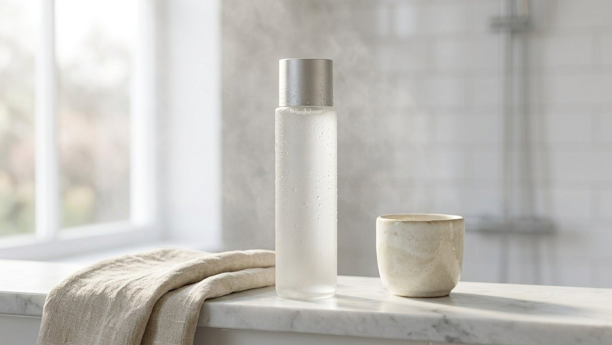
At home on any counter.
DEW-02 · THE DOOR SHELF, KEPT CLEAR · THE BOTTLE, KEPT COMING
Notes:
The home scene closes the argument the numbers opened.

Slide 14
Stock the culture.
DEW-02 · $38 · THE CULTURE IS READY WHEN THE COUNTER IS
EACH BRAND OPERATES INDEPENDENTLY. ALL CUSTOMER DATA IS POOLED FOR YOUR CONVENIENCE.
Notes:
Leave a bottle. It will do the follow-up.

