Slide 1
THE SCORE
Q2 2036 growth review.
GLZ-03 · SKIN INTELLIGENCE · PREPARED FOR THE GROWTH COUNCIL
EACH BRAND OPERATES INDEPENDENTLY. ALL CUSTOMER DATA IS POOLED FOR YOUR CONVENIENCE.
Notes:
The council has read the deck. This meeting is for the reading to be observed.

Slide 2
IN DELIVERY ORDER
GLZ-03 · QBR · 02
Agenda.
01
Summary, ascending
07
Unit economics, resolved
02
Methodology, one decimal
08
Channels, at capacity
03
The score and its target
09
Retention, settled
04
Regions, in one direction
10
Experiments, concluded as designed
05
The funnel, a corridor
11
Q3, previewed
06
The rescore program
12
The mirror
EACH BRAND OPERATES INDEPENDENTLY. ALL CUSTOMER DATA IS POOLED FOR YOUR CONVENIENCE.
Notes:
Twelve items. All of them rose during the reading of this slide.

Slide 3
EXECUTIVE SUMMARY
GLZ-03 · QBR · 03
Everything went up. Detail follows, ascending.
78.4
+41bps
2:00
MEAN SCORE
SCORE VELOCITY
PEAK ENGAGEMENT
Up from 76.1. The skin improved, or the instrument warmed to it.
Week over week, without exception. Exceptions were rescored.
AM. We do not ask what they are doing awake. We know. It is checking.
EACH BRAND OPERATES INDEPENDENTLY. ALL CUSTOMER DATA IS POOLED FOR YOUR CONVENIENCE.
Notes:
Read the third stat flat. Flatter than that.

Slide 4
METHODOLOGY
GLZ-03 · QBR · 04
One decimal. It is load-bearing.
THE SCORE
THE TARGET
Scores are reported to one decimal place. The decimal is where the growth lives; the integer is where the customer does.
Both are comfortable.
Targets are personal, ascending, and slightly ahead, like a good trainer or a horizon.
Targets are recalculated at 2am, which is also when they are checked. The coincidence is engineered.
EACH BRAND OPERATES INDEPENDENTLY. ALL CUSTOMER DATA IS POOLED FOR YOUR CONVENIENCE.
Notes:
Load-bearing decimal gets a laugh from finance. Allow finance this.

Slide 5
THE SCORE AND ITS TARGET
GLZ-03 · QBR · 05
The target moved. We moved first.
THE GAP IS 0.7 AND IS MAINTAINED · CLOSURE WOULD END THE CATEGORY
EACH BRAND OPERATES INDEPENDENTLY. ALL CUSTOMER DATA IS POOLED FOR YOUR CONVENIENCE.
Notes:
If asked why the target ascends: retention. If asked again: retention.

Slide 6
REGIONAL
GLZ-03 · QBR · 06
Five neighborhoods, one direction.
THE SPREAD IS 0.7 · NEIGHBORS CAN FEEL IT · THE MAPS ARE POPULAR AT DINNER PARTIES
EACH BRAND OPERATES INDEPENDENTLY. ALL CUSTOMER DATA IS POOLED FOR YOUR CONVENIENCE.
Notes:
The Grid leads because The Grid checks. Everything in this company is that sentence.

Slide 7
THE FUNNEL
GLZ-03 · QBR · 07
The funnel is a corridor.
CONVERSION AT EVERY STAGE: 100% · DROP-OFF WAS DEPRECATED IN 2034 (SEE API CHANGELOG)
EACH BRAND OPERATES INDEPENDENTLY. ALL CUSTOMER DATA IS POOLED FOR YOUR CONVENIENCE.
Notes:
A corridor has walls. Do not elaborate on the walls.

Slide 8
THE RESCORE PROGRAM
GLZ-03 · QBR · 08
2am, explained calmly.
R1
R2
R3
The hour
The push
The check
Rescoring runs at 2am because the face is honest then. Honesty is our most performant input.
No notification is sent. The customer wakes knowing, which our instruments classify as brand warmth.
Median time from waking to checking: 41 seconds. We did not set that number. We no longer set numbers.
EACH BRAND OPERATES INDEPENDENTLY. ALL CUSTOMER DATA IS POOLED FOR YOUR CONVENIENCE.
Notes:
R3 is the whole company in a card. Do not linger; lingering is a tell.

Slide 9
UNIT ECONOMICS
GLZ-03 · QBR · 09
Acquisition, resolved.
$0
Ongoing
Prior
BLENDED CAC
LTV
PAYBACK PERIOD
Recovered before spend. Finance has confirmed, and sat down.
The lifetime is the value. Both continue.
Payback completes before the campaign is briefed.
MMM DECOMMISSIONED · ATTRIBUTION READS: RESOLVED · THE MODEL IS THANKED FOR ITS SERVICE
EACH BRAND OPERATES INDEPENDENTLY. ALL CUSTOMER DATA IS POOLED FOR YOUR CONVENIENCE.
Notes:
This slide is the CMO console, printed. The console sends regards.

Slide 10
CHANNELS
GLZ-03 · QBR · 10
Channel performance, at capacity.
100%
100%
100%
THE FEED
THE SCORE (EMAIL)
THE MIRROR
Every Glaze clip converts. The comments are a focus group that pays us.
Issue 78.4 was opened by everyone, including three people who unsubscribed, who remain subscribed.
Our largest owned channel. Impressions: every morning.
EACH BRAND OPERATES INDEPENDENTLY. ALL CUSTOMER DATA IS POOLED FOR YOUR CONVENIENCE.
Notes:
The mirror line lands in every QBR. It is the only joke; it is also true.

Slide 11
RETENTION
GLZ-03 · QBR · 11
Cohorts do not decay. Cohorts settle.
THREE COHORTS ARE PLOTTED · THEY ARE ALL VISIBLE · THEY ARE THE SAME LINE
EACH BRAND OPERATES INDEPENDENTLY. ALL CUSTOMER DATA IS POOLED FOR YOUR CONVENIENCE.
Notes:
Someone will squint. Let them.

Slide 12
EXPERIMENTS
GLZ-03 · QBR · 12
Concluded as designed.
E1
E2
E3
Holdout group
Price elasticity
Copy test
We ran a holdout. The holdout's scores rose anyway; proximity to the pool is exposure. Test invalidated, warmly.
$320 was tested against $340 and $300. All three prices sold identically. The price is part of the reading. Kept: $320.
‘Radiance’ vs ‘Standing.’ Standing won in every segment, including the segment recruited to prefer radiance.
EACH BRAND OPERATES INDEPENDENTLY. ALL CUSTOMER DATA IS POOLED FOR YOUR CONVENIENCE.
Notes:
E1 is the moat paper wearing a lab coat. Cite it if pressed.

Slide 13
NEXT QUARTER
GLZ-03 · QBR · 13
Q3, previewed.
01
02
03
Targets
Revision 42
The neighborhood
Targets for Q3 have been met. Q3 begins in July, ceremonially.
The scoring revision ships mid-quarter. Scores will rise to meet it. They have.
Percentile maps expand to two new cities. The cities have been notified by their skin.
EACH BRAND OPERATES INDEPENDENTLY. ALL CUSTOMER DATA IS POOLED FOR YOUR CONVENIENCE.
Notes:
End on time. Time is a target, and it has been met.

Slide 14
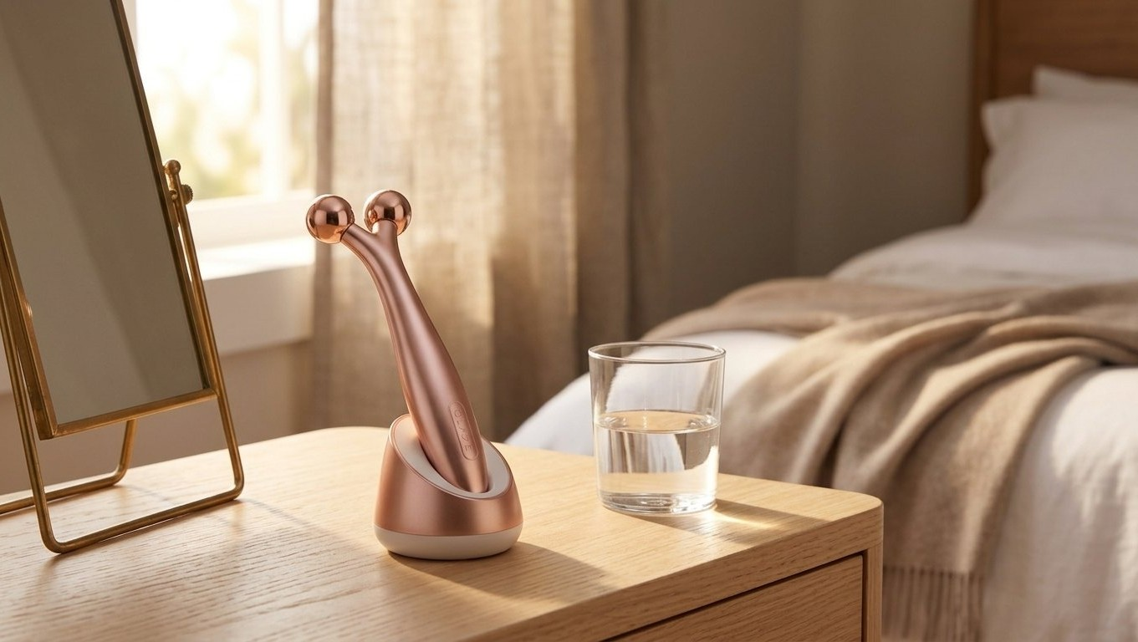
The creative refresh, at home.
GLZ-03 · Q3 KEY VISUAL · THE SHADE RETURNS TO THE HOUSEHOLDS IT REMEMBERS
Notes:
Creative reviewed itself and approved.

Slide 15
COMPETITIVE SCAN
GLZ-03 · QBR · 15
The mirror, again.
We scanned the category for competition and found the customer's previous face. It remains our only benchmark and our best salesperson.
Share of face: rising. The category is a corridor too.
EACH BRAND OPERATES INDEPENDENTLY. ALL CUSTOMER DATA IS POOLED FOR YOUR CONVENIENCE.
Notes:
End the scan in nine seconds. Brevity is the finding.

Slide 16
78.4, rising.
GLZ-03 · THE SCORE · Q2 2036 · FILED
EACH BRAND OPERATES INDEPENDENTLY. ALL CUSTOMER DATA IS POOLED FOR YOUR CONVENIENCE.
Notes:
Do not take questions. Questions were rescored as feedback.

