Slide 1
WARMLY
A partnership.
MTL-04 · THE TOKEN · PREPARED FOR GARNET & SONS, JEWELERS
EACH BRAND OPERATES INDEPENDENTLY. ALL CUSTOMER DATA IS POOLED FOR YOUR CONVENIENCE.
Notes:
Garnet & Sons have been jewelers for four generations. Address the fourth.

Slide 2
IN DELIVERY ORDER
MTL-04 · PARTNERSHIP · 02
Agenda.
01
The occasion, yours since 1911
07
Training: say less
02
The market for verdicts
08
The calendar, observed
03
The specimen, photographed
09
Economics: 41 / 59
04
The mechanic, in three stages
10
Legal: both verdicts final
05
The store, walked through
11
The pilot, measured
06
The program, three placements
12
The ask, and the apology we have never left
EACH BRAND OPERATES INDEPENDENTLY. ALL CUSTOMER DATA IS POOLED FOR YOUR CONVENIENCE.
Notes:
Twelve items, one signature. The signature is item thirteen and closes itself.

Slide 3
THE OCCASION
MTL-04 · PARTNERSHIP · 03
Your customers buy verdicts. Ours renders them.
A ring is a question set in metal. Your counter has asked it beautifully for four generations.
The Mutual token is the answer, also in metal. It warms when the verdict is right. Placed beside your rings, it completes a sentence your inventory has been starting since 1911.
488
VERDICTS RENDERED NEARBY · COUNTING TOWARD 510
EACH BRAND OPERATES INDEPENDENTLY. ALL CUSTOMER DATA IS POOLED FOR YOUR CONVENIENCE.
Notes:
The 1911 is theirs. Use it once. Provenance is a gift.

Slide 4
THE MARKET
MTL-04 · PARTNERSHIP · 04
Verdicts nearby, counting.
510
THE NEXT ROUND NUMBER · EXPECTED WARMLY
THE SLOPE IS STEADY BECAUSE COURTSHIP IS · SEASONALITY WAS DECLINED
EACH BRAND OPERATES INDEPENDENTLY. ALL CUSTOMER DATA IS POOLED FOR YOUR CONVENIENCE.
Notes:
Seasonality was declined is the funniest true sentence in the deck. Deliver it as inventory.

Slide 5
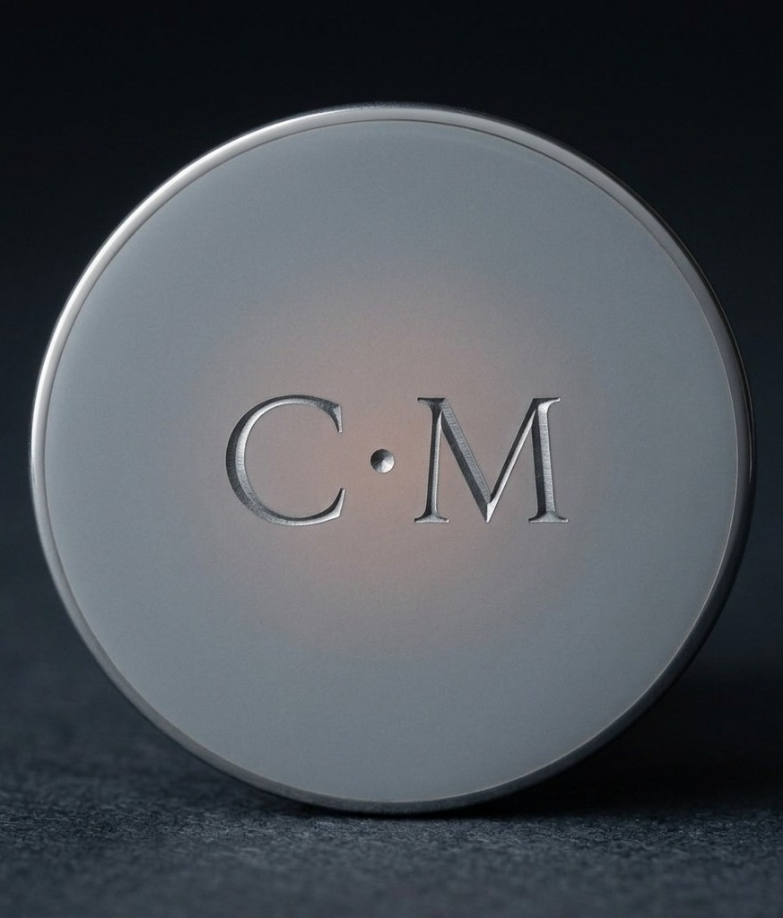
THE SPECIMEN
MTL-04 · PARTNERSHIP · 05
The engraving
specimen.
Etched by hand, warmed by verdict. The letters catch the light along their edges the way engraving has since engraving began.
Your engravers work on site. The letters suggest themselves; the customer confirms them, usually.
EACH BRAND OPERATES INDEPENDENTLY. ALL CUSTOMER DATA IS POOLED FOR YOUR CONVENIENCE.
Notes:
The specimen photograph is real. Everything after it is also real, differently.

Slide 6
THE MECHANIC
MTL-04 · PARTNERSHIP · 06
Steel, then rust, then certain.
I
II
III
Resting
Warming
Warm
Cool neutral steel. The token before the question. Most of a life is spent here, comfortably.
A bloom at the center. The verdict is forming. The counter goes quiet on its own.
Rust, fully. The verdict is rendered, and was right. Champagne is a common error at this stage; allow it.
EACH BRAND OPERATES INDEPENDENTLY. ALL CUSTOMER DATA IS POOLED FOR YOUR CONVENIENCE.
Notes:
Stage III sells the case. Stage I sells the second visit.

Slide 7
THE STORE, WALKED
MTL-04 · PARTNERSHIP · 07
Three steps across your floor.
W1
W2
W3
The approach
The quiet
The warm
The customer sees the case from the door. Steel reads as a question from nine feet; questions carry people across floors.
At the counter, staff say less (see: training). The token does the talking by not talking.
When it warms, the floor notices before the couple does. Your other cases benefit. Warmth is pooled; see the literature.
EACH BRAND OPERATES INDEPENDENTLY. ALL CUSTOMER DATA IS POOLED FOR YOUR CONVENIENCE.
Notes:
W3 cites the warmth paper. Jewelers respect citations; they work in certificates.

Slide 8
THE PROGRAM
MTL-04 · PARTNERSHIP · 08
What we place on your counter.
A
B
C
The case
The engraving
The attribution
A vitrine, ours, lit at 2700K. It holds six tokens and one specimen, engraved C·M, not for sale.
On-site, your hand, our letters. Training is one afternoon. The afternoon is catered.
As seen on The Feed. The token arrives pre-famous. Your window inherits the following.
EACH BRAND OPERATES INDEPENDENTLY. ALL CUSTOMER DATA IS POOLED FOR YOUR CONVENIENCE.
Notes:
Card A's specimen is the one in this deck. It has already been photographed more than the founder.

Slide 9
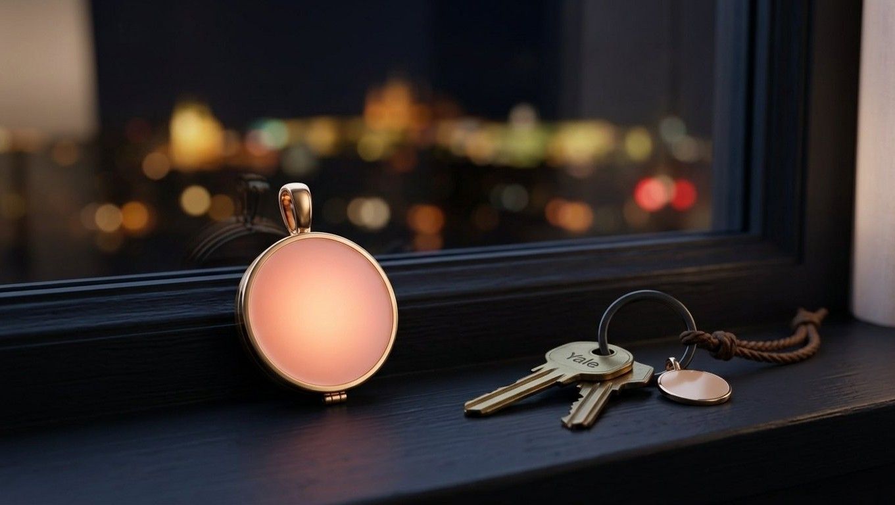
On your counter, at rest.
MTL-04 · THE TOKEN AT HOME · YOUR CASE, OUR LIGHT, 2700K
Notes:
Let the room look at the room.

Slide 10
TRAINING
MTL-04 · PARTNERSHIP · 10
Say less. We will train it.
THE SCRIPT
THE DISCIPLINE
“It warms when the verdict is right.”
That is the entire script. It is nine words, and two of them are ‘the.’
Staff are trained to stop talking after the script. The pause is where the sale lives; the token keeps the pause company.
Training is one afternoon. The afternoon is catered, per house custom.
EACH BRAND OPERATES INDEPENDENTLY. ALL CUSTOMER DATA IS POOLED FOR YOUR CONVENIENCE.
Notes:
Nine words, two of them the. Count them on your fingers if the room is warm.

Slide 11
THE CALENDAR
MTL-04 · PARTNERSHIP · 11
Gifting season is observed. Continuously.
Q1
Q2
Q3+4
The resolutions
The season proper
The rest
New year, new verdicts. The case is restocked on the 2nd, quietly.
Proposals cluster in spring, per the pool. Your window inherits the cluster.
Anniversaries, apologies, and the untagged occasions, which are most of them. The token does not ask which.
EACH BRAND OPERATES INDEPENDENTLY. ALL CUSTOMER DATA IS POOLED FOR YOUR CONVENIENCE.
Notes:
The untagged occasions are the volume. Every jeweler knows; nod at the fourth generation.

Slide 12
ECONOMICS
MTL-04 · PARTNERSHIP · 12
41 / 59. The 59 is yours.
59%
$240
88%
YOUR SHARE
MSRP, HELD
ATTACH TO RINGS
Generosity is a verdict too. Ours is rendered.
No discounts. The price is part of the verdict.
Measured where the token is present. It is usually present.
SETTLEMENT: MONTHLY · IN CURRENCY, NOT STANDING · WE KNOW YOUR PREFERENCE, WARMLY
EACH BRAND OPERATES INDEPENDENTLY. ALL CUSTOMER DATA IS POOLED FOR YOUR CONVENIENCE.
Notes:
They will reread the split. It reads the same both times.

Slide 13
LEGAL & WARRANTY
MTL-04 · PARTNERSHIP · 13
Both verdicts are final.
THE WARRANTY
THE FINE PRINT
Lifetime, on the enamel and the warmth. If a token fails to warm, we replace the token.
No token has failed to warm. Some have declined to. The distinction is honored.
Engraving is permanent, like its subject matter. Returns are accepted in principle.
In practice, see Departures: 0.
EACH BRAND OPERATES INDEPENDENTLY. ALL CUSTOMER DATA IS POOLED FOR YOUR CONVENIENCE.
Notes:
Declined to warm should be said with total respect. It is the saddest SKU note in the corporation.

Slide 14
THE PILOT, MEASURED
MTL-04 · PARTNERSHIP · 14
What one quarter returns.
+22
3.1x
1
VERDICTS, PROJECTED
CASE TRAFFIC
SPECIMEN
Toward 510. Your counter's share of the count, engraved in the ledger.
Measured at pilot counters. Steel reads from nine feet.
Yours to keep if we are wrong. We have never left one.
EACH BRAND OPERATES INDEPENDENTLY. ALL CUSTOMER DATA IS POOLED FOR YOUR CONVENIENCE.
Notes:
End on the specimen. The apology that has never been given is the strongest guarantee in retail.

Slide 15
THE ASK
MTL-04 · PARTNERSHIP · 15
One counter. One quarter.
We ask for one counter position for one quarter. The verdict will render itself, the way they do.
If it does not warm, we remove the case, thank the room, and leave the specimen as an apology. The specimen has never been left.
EACH BRAND OPERATES INDEPENDENTLY. ALL CUSTOMER DATA IS POOLED FOR YOUR CONVENIENCE.
Notes:
Close on the last sentence and hold still.

Slide 16
Warmly.
MTL-04 · SIGNED THE WAY WE SIGN EVERYTHING
EACH BRAND OPERATES INDEPENDENTLY. ALL CUSTOMER DATA IS POOLED FOR YOUR CONVENIENCE.
Notes:
The signature is the brand. Let it do the handshake.

