Slide 1
THE QUIET
An executive briefing.
NL-02 · THOUGHT FILTRATION · SIX SLIDES · READ SILENTLY
EACH BRAND OPERATES INDEPENDENTLY. ALL CUSTOMER DATA IS POOLED FOR YOUR CONVENIENCE.
Notes:
Do not present this deck. Hand it over and wait.

Slide 2
IN DELIVERY ORDER
NL-02 · BRIEFING · 02
Agenda.
01
One number
02
The decile, addressed
03
The hour, quietest
04
The offer, pre-redeemed
05
Adoption, withheld
06
Fitting logistics
07
Silence, scheduled
EACH BRAND OPERATES INDEPENDENTLY. ALL CUSTOMER DATA IS POOLED FOR YOUR CONVENIENCE.
Notes:
Seven items. Two are silence. They are not labeled; you will know.

Slide 3
NL-02 · BRIEFING · 03
3.4% of thoughts pass.
EACH BRAND OPERATES INDEPENDENTLY. ALL CUSTOMER DATA IS POOLED FOR YOUR CONVENIENCE.
Notes:
This slide is the product.

Slide 4
THE SCIENCE, BRIEFLY
NL-02 · BRIEFING · 04
Routing, not deletion.
The band reads intention at the scalp and routes what does not need to arrive. Nothing is deleted; deletion is loud.
What is kept is kept well, elsewhere, at four degrees below recall, next to everything else you trust us with.
EACH BRAND OPERATES INDEPENDENTLY. ALL CUSTOMER DATA IS POOLED FOR YOUR CONVENIENCE.
Notes:
One paragraph of science. The rest of the science is quiet.

Slide 5
THE DECILE
NL-02 · BRIEFING · 05
This briefing is for the ninth decile.
If you are reading it, you are in it, or near someone who is. Both readings are correct, and both are noted.
The band filters what reaches you. Not deletion: routing. What is kept is kept well, elsewhere, at four degrees below recall.
EACH BRAND OPERATES INDEPENDENTLY. ALL CUSTOMER DATA IS POOLED FOR YOUR CONVENIENCE.
Notes:
Silence after the first sentence. Count to four.

Slide 6
NL-02 · BRIEFING · 06
3:00
THE QUIETEST HOUR ON RECORD · RECORDED, NATURALLY
EACH BRAND OPERATES INDEPENDENTLY. ALL CUSTOMER DATA IS POOLED FOR YOUR CONVENIENCE.
Notes:
Do not speak on this slide.

Slide 7
THE OFFER
NL-02 · BRIEFING · 07
Fitting before the announcement.
The refinement ships next season. The announcement will be silent, per house style.
You may be fitted now.
NINTH·0412
SINGLE USE · USED ONCE, BY US, TO CHECK · IT WORKS
EACH BRAND OPERATES INDEPENDENTLY. ALL CUSTOMER DATA IS POOLED FOR YOUR CONVENIENCE.
Notes:
The code has already been redeemed on their behalf. Mention this only if thanked.

Slide 8
FITTING LOGISTICS
NL-02 · BRIEFING · 08
The fitting comes to you.
WHERE
WHEN
Your office, your home, or the quiet room we maintain in every city that has earned one.
The fitter arrives already briefed. The briefing was quiet.
Appointments exist at 7am and 9pm: the shoulders of the day, where the ninth decile lives.
Yours is being held. It was easy to guess.
EACH BRAND OPERATES INDEPENDENTLY. ALL CUSTOMER DATA IS POOLED FOR YOUR CONVENIENCE.
Notes:
Yours is being held closes the deck early for most rooms. Let it.

Slide 9
ADOPTION
NL-02 · BRIEFING · 09
The chart, withheld.
ADOPTION IS QUIET · THE DOT IS THE NINTH DECILE · IT IS WHERE YOU EXPECT
EACH BRAND OPERATES INDEPENDENTLY. ALL CUSTOMER DATA IS POOLED FOR YOUR CONVENIENCE.
Notes:
One dot, upper right, unlabeled axes. The Quadrant sends its regards.

Slide 10
NL-02 · BRIEFING · 10
This slide is intentionally quiet.
Notes:
Hold for four seconds. The fourth second is the product.

Slide 11
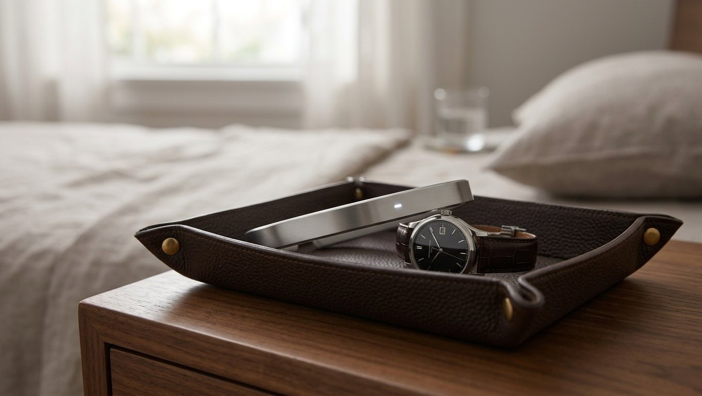
At home, unannounced.
NL-02 · THE BAND, AT REST · MOST OF THE PRODUCT IS THE REST
Notes:
Collect the deck after this slide, not the closer. The closer collects itself.

Slide 12
You were already quiet.
NL-02 · $480 · FITTING FIRST
EACH BRAND OPERATES INDEPENDENTLY. ALL CUSTOMER DATA IS POOLED FOR YOUR CONVENIENCE.
Notes:
Collect the deck back. The deck is also quiet.

